Slide 1

Universal Approximation Theorem (UAT)
Multi Layer Perceptron
Feed forward Neural Network

Slide 2
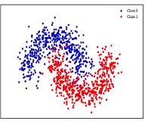
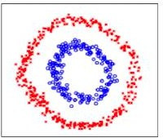
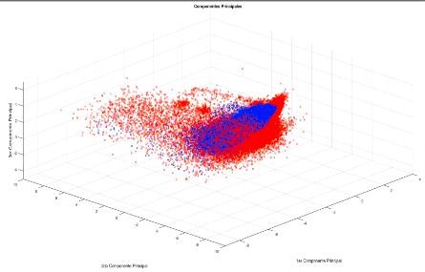
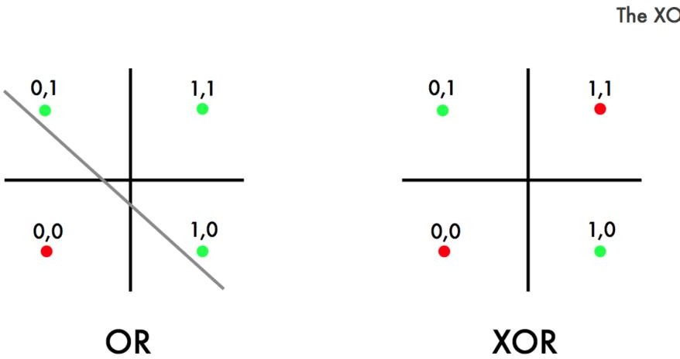
Non linearly separated data
XOR problem

Slide 3

Analogy
You can think of the house as a complex function, the way we will build a house is we start with a building a block i.e... brick in this case. First, we will lay the foundation and on top of that we will lay another layer and we will just keep continuing in this manner till we get very complex output i.e… house. In this process, we are combining the very simple building blocks in an effective way so that we can get this house.

Slide 4
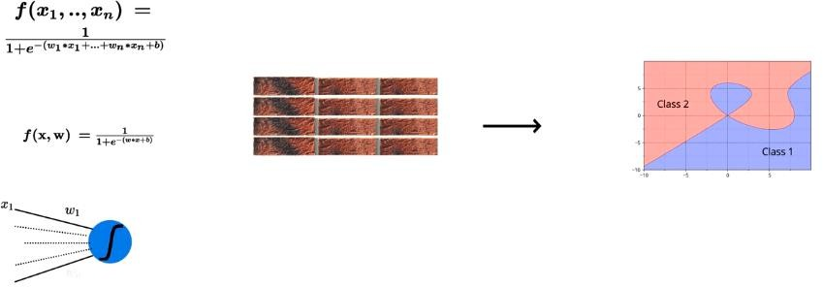
Universal Approximation Theorem (UAT)
UAT says that — you can always come up with a deep neural network that will approximate any complex relation between input and output.
In the mathematical theory of artificial neural networks, the universal approximation theorem states that a feed-forward network with a single hidden layer containing a finite number of neurons can approximate continuous functions on compact subsets of Rn, under mild assumptions on the activation function.

Slide 5
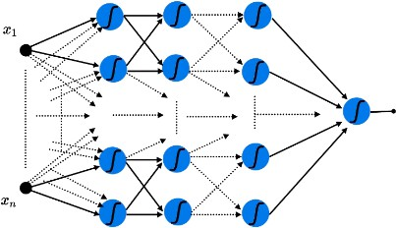
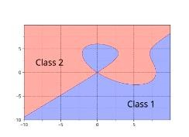
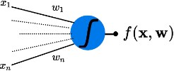
Modelling Complex Functions
Deep neural network with a certain number of hidden layers should be able to approximate any function that exits between input and output.

Slide 6
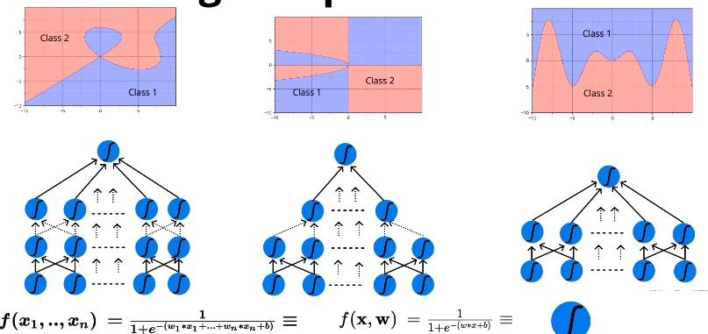
Universal Approximation Theorem (UAT)

Slide 7
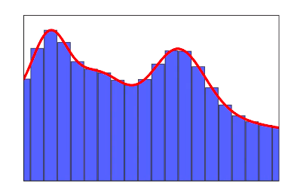
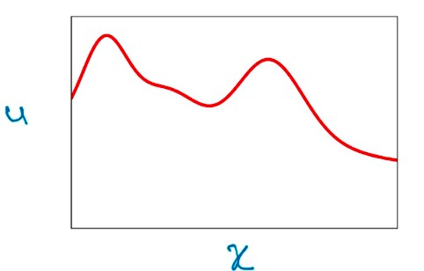
Illustrative proof of UAT
For this illustrative proof, we will consider a simple example where we have one-dimensional input x and output y, the graph shown above represents the true relationship between input and the output. Let’s assume that we don’t know what that function equation between x and y and we can’t come up with a representation for the equation.
To solve this problem, we will break this function into multiple smaller parts so that each part is represented by a simpler function. By combining the series of smaller functions (rectangular bars/towers) I can approximate the relation between x and y as close to the true relationship possible.

Slide 8
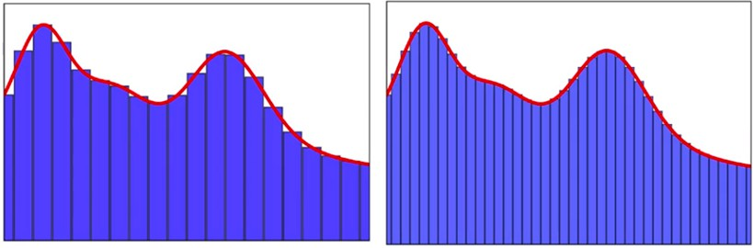
The key point to note in this case is that we don’t have to worry about coming up with complex equations to represent the relationship between input and output. we can just come up with a simple function and use the combination of these functions to approximate the relationship to my true relationship. The more functions that I choose in this method the better will be my approximation.

Slide 9
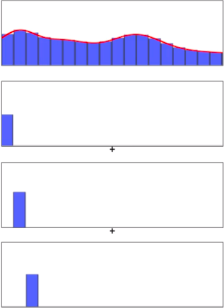
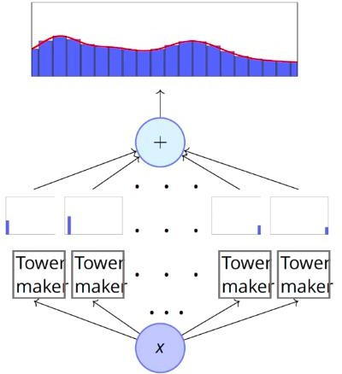
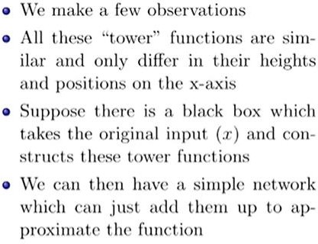
Illustrative proof of UAT

Slide 10
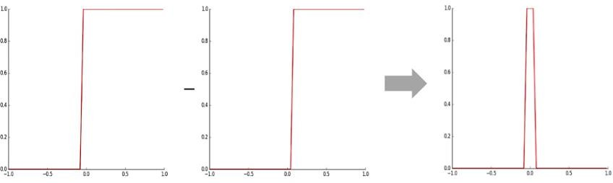
How do we come up with these rectangles/towers and how it will tie back to the sigmoid neuron?
Let’s take two step functions having a very steep slope and notice that they have a different place at which they peak. The left sigmoid peaks just before zero and right sigmoid peaks just after zero. If we just subtract these two functions the net effect is going to be a tower (rectangular output).

Slide 11
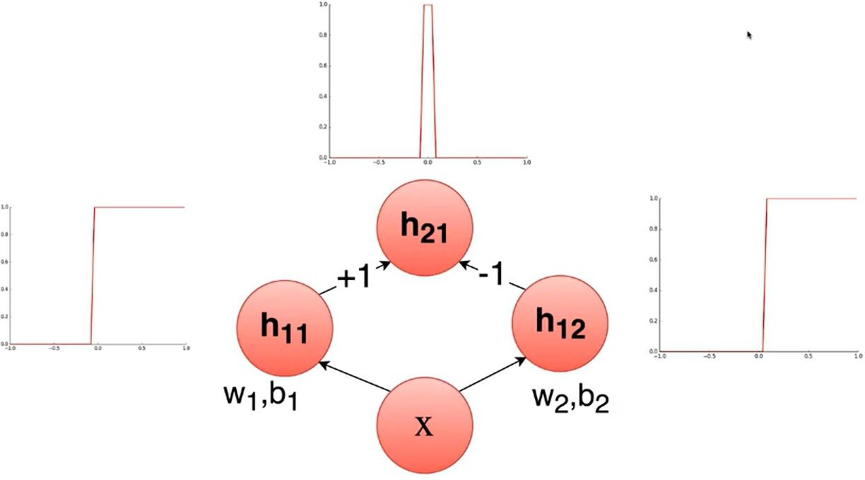
Neural Network-Can we come up with a neural network to represent this operation of subtracting one
if we have an input x and it is passed through the two sigmoid neurons and the output from these two neurons are combined in another neuron with weights +1 and -1 i.e… same is as subtracting these two outputs, then we will get our tower.
step/sigmoid function from another?.
If we can construct many such building blocks and add all of them up, we can approximate any complex true relationship between input and output. This is called the representational power of deep neural networks, to approximate any kind of relationship between input and output.

Slide 12

Feed Forward Neural Networks- Introduction
Citation Note: The content, of this presentation were inspired by the awesome lectures and
the material offered by Prof. Mitesh M. Khapra on NPTEL’s Deep Learning course

Slide 13
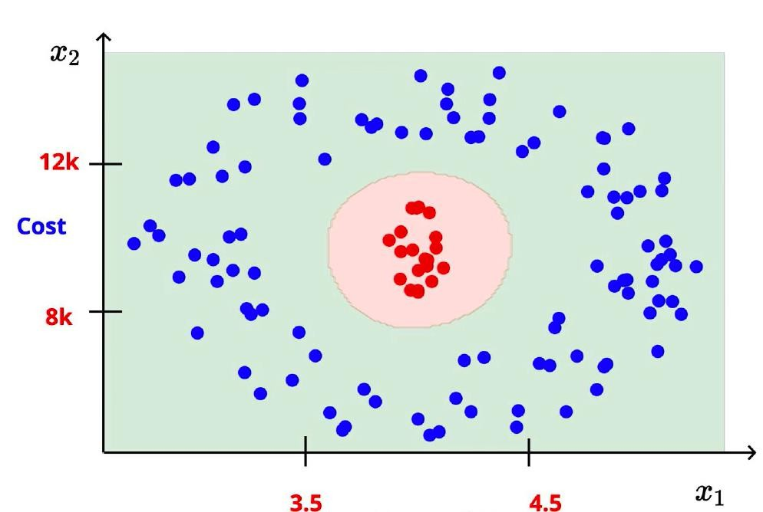
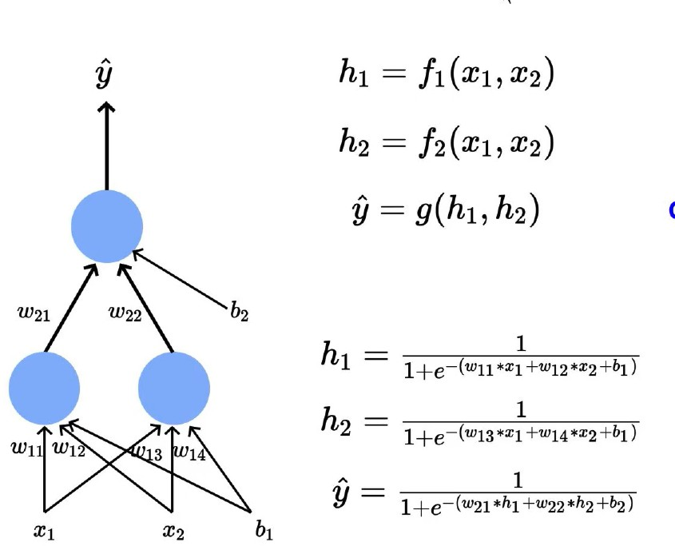

Multiple sigmoid Neurons

Slide 14
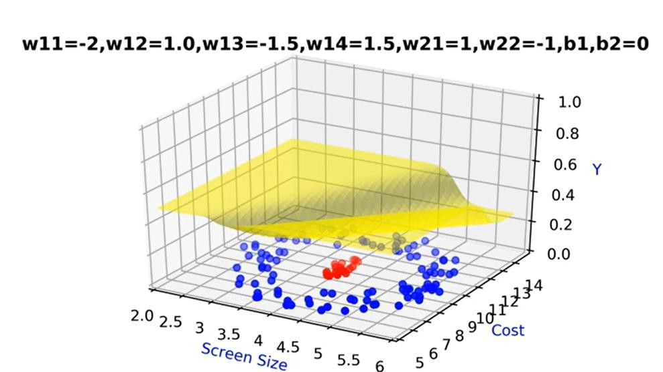

Multiple sigmoid Neurons

Slide 15
Multiple sigmoid Neurons

Slide 16
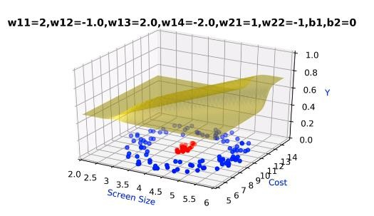
Multiple sigmoid Neurons

Slide 17
Multiple sigmoid Neurons

Slide 18
Multiple sigmoid Neurons

Slide 19
Multi Layer Neural Networks

Slide 20
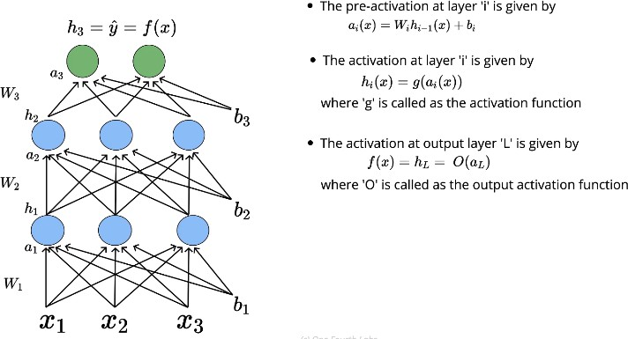
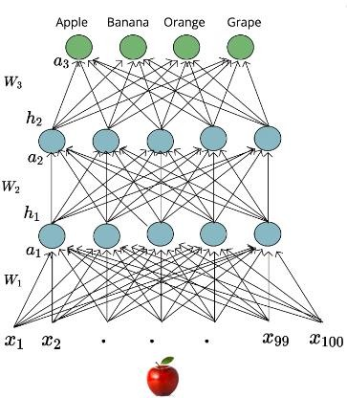
Feed Forward Neural Networks

Slide 21
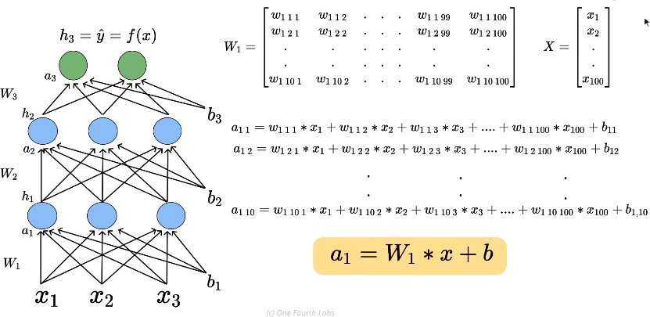

Understanding the computation
^{W}111^{= W} Layer no, Neuron in the next layer ,Input Neuron
Feed Forward Neural Networks

Slide 22
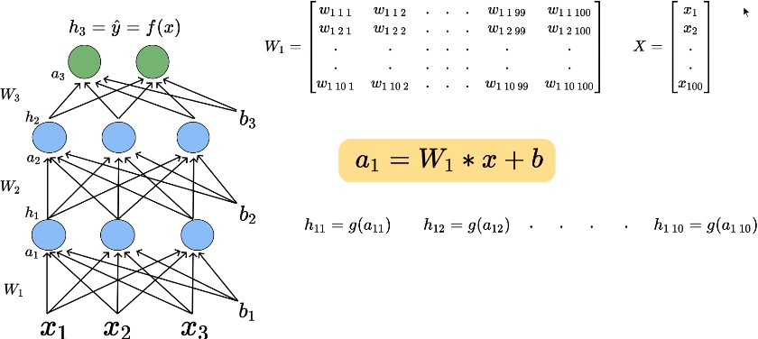

Feed Forward Neural Networks

Slide 23
Feed Forward Neural Networks

Slide 24
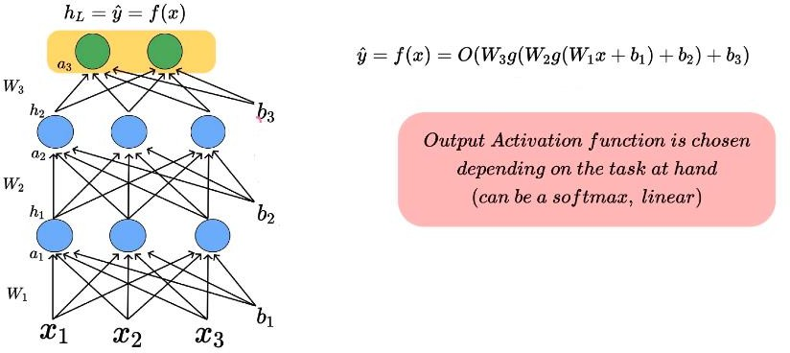
Feed Forward Neural Networks

Slide 25

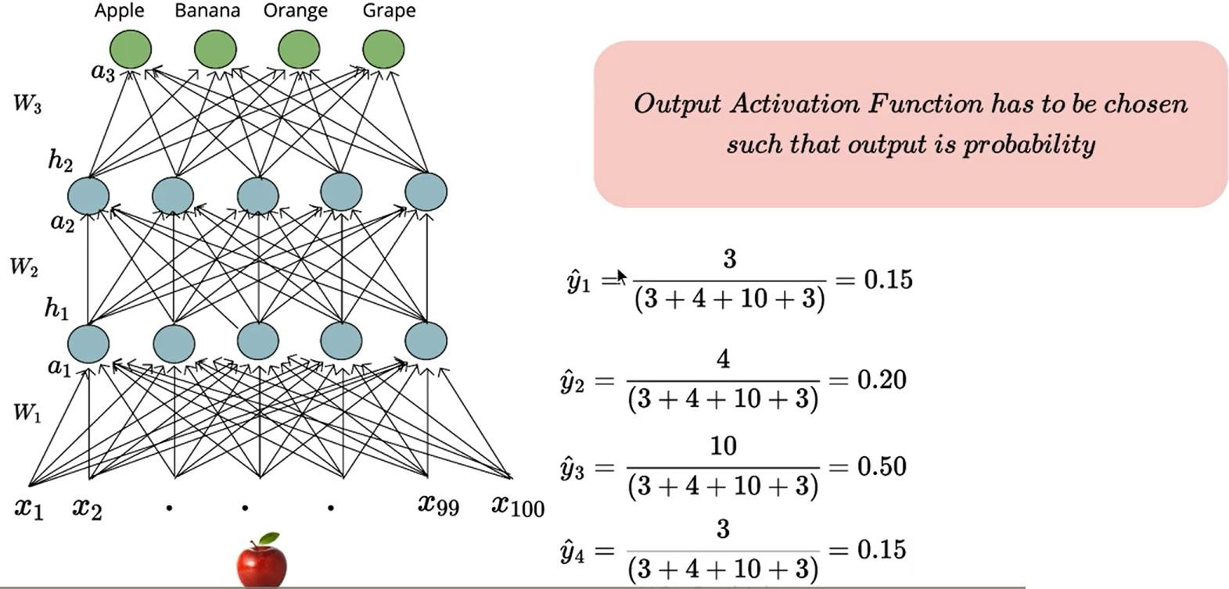

Is this ok?

Slide 26
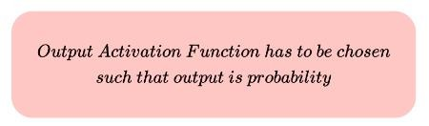
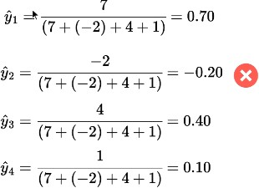
Output Layer
Is this ok?-No

Slide 27
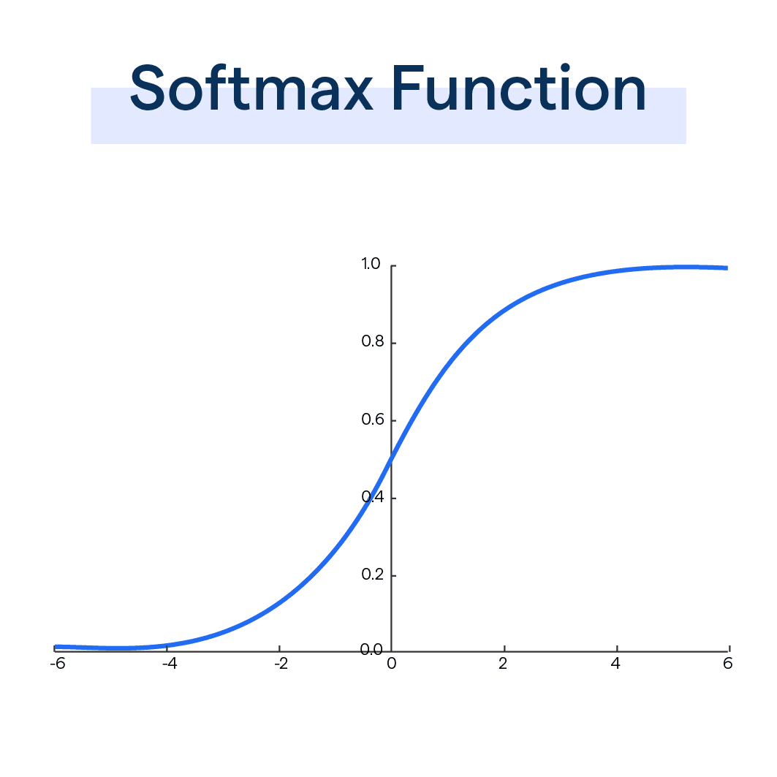

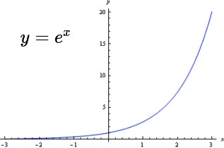
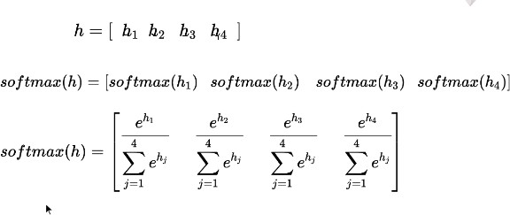
Softmax is a kind of activation function with the speciality of output summing to 1.
Softmax

Slide 28
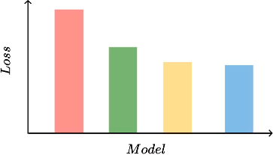
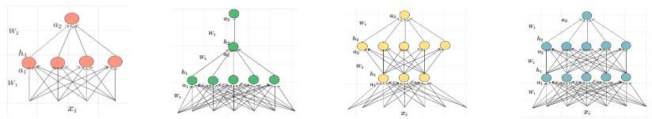
Different network configurations

Slide 29
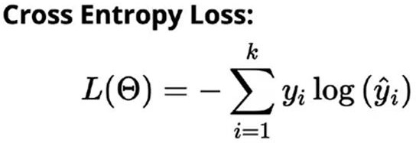

Cross Entropy Loss Function
Cross Entropy Loss- binary class
Multiclass
Also called logarithmic loss, log loss or logistic loss.
Each predicted class probability is compared to the actual class desired output 0 or 1 and a score/loss is calculated that penalizes the probability based on how far it is from the actual expected value.
The penalty is logarithmic in nature yielding a large score for large differences close to 1 and small score for small differences tending to 0.
Cross-entropy loss is used when adjusting model weights during training. The aim is to minimize the loss, i.e,
the smaller the loss the better the model. A perfect model has a cross-entropy loss of 0.

Slide 30
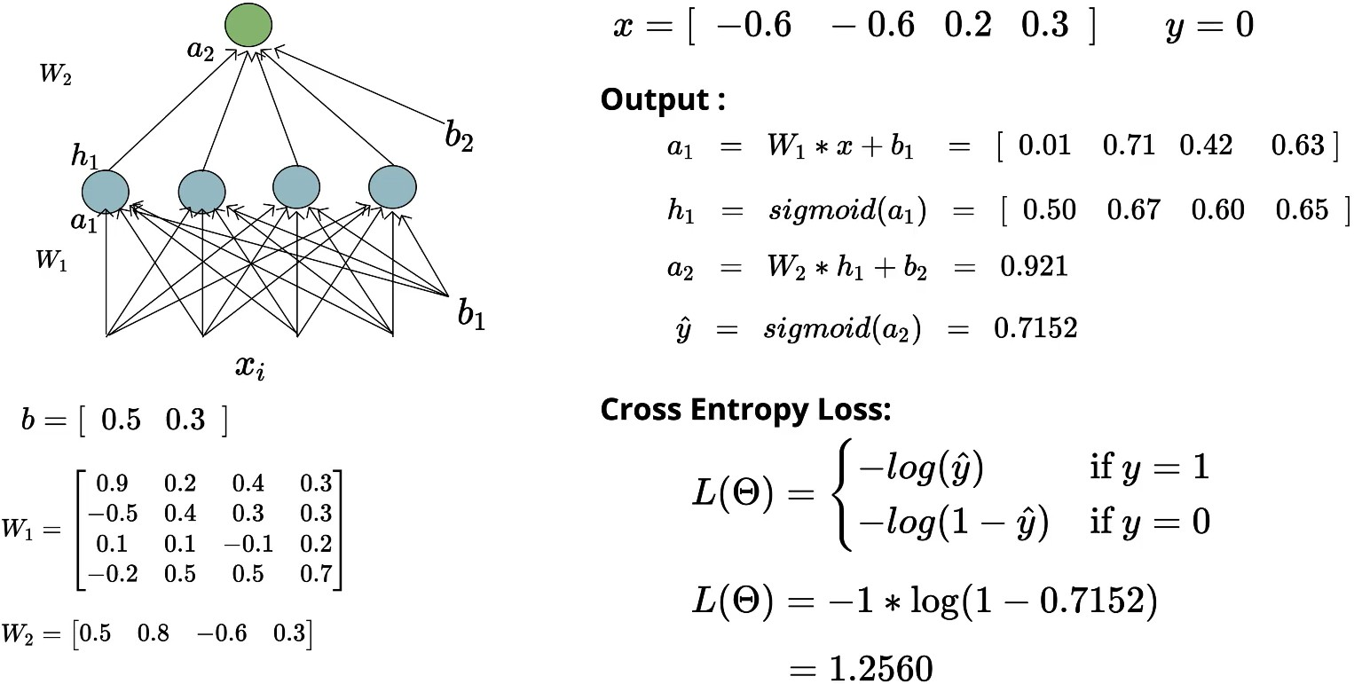
Loss function for binary class classification

Slide 31
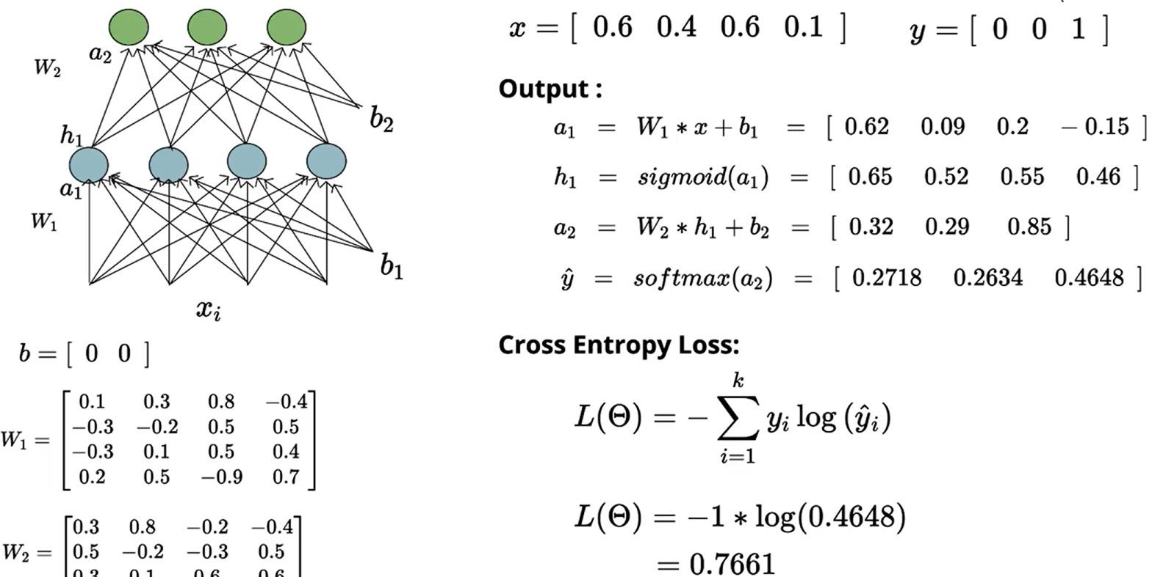
Loss function for multi class classification

Slide 32
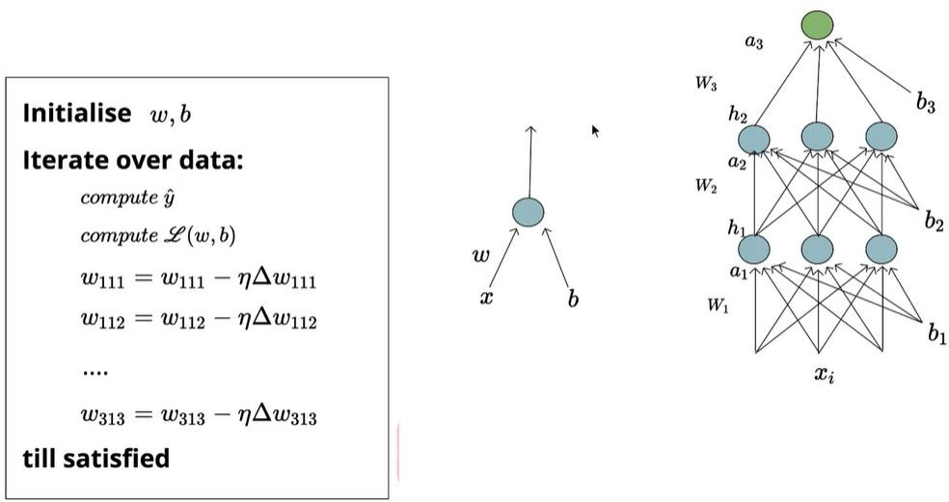

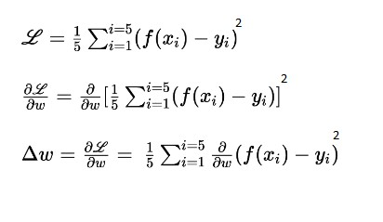
Learning Algorithm- backpropagation

Slide 33
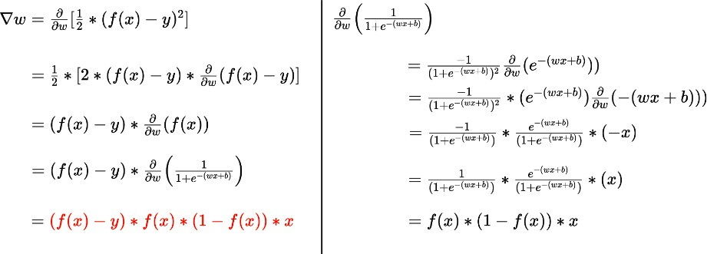
Calculation of

Slide 34
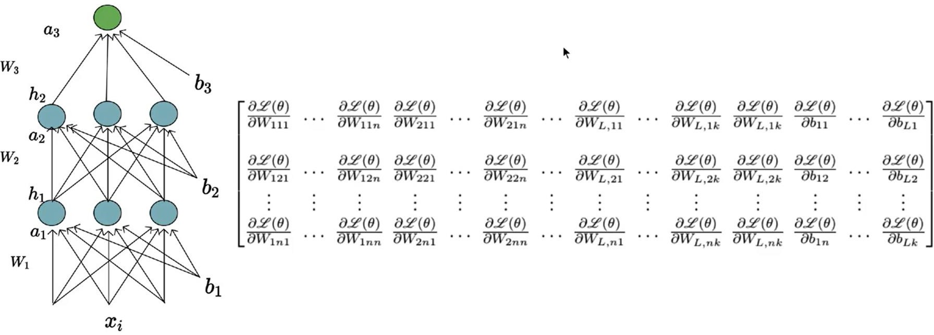
Partial derivative , Gradient
The partial derivative notation is used to specify the derivative of a function of more than one variable with respect to one of its variables.
The gradient of a function f, denoted as ∇f , is the collection of all its partial derivatives into a vector.

Slide 35
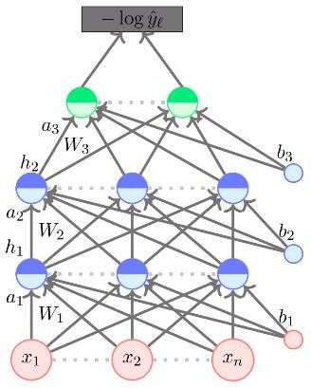
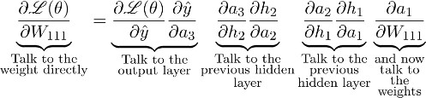
Backpropagation
The partial derivative notation is used to specify the derivative of a function of more than one variable with respect to one of its variables.
The gradient of a function f, denoted as ∇f , is the
collection of all its partial derivatives into a vector.

Slide 36
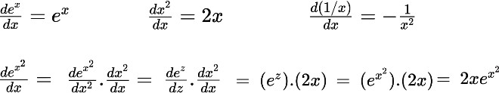
Calculus basics - Chain rule
The chain rule is a method for finding the derivative of composite functions, or functions that are made by combining one or more functions.
h=f(x) Y=f(h)= e^{h}
𝑑𝑦 𝑑𝑦 𝑑ℎ 𝑑e^{h} 𝑑x²
= = = e^{h} 2x=2x e^{x2}
Y= f(h)= e^{h}
= _{e}x2
x
sqr
h=x²
𝑑𝑥 𝑑ℎ 𝑑𝑥 𝑑ℎ 𝑑𝑥
exp

Slide 37



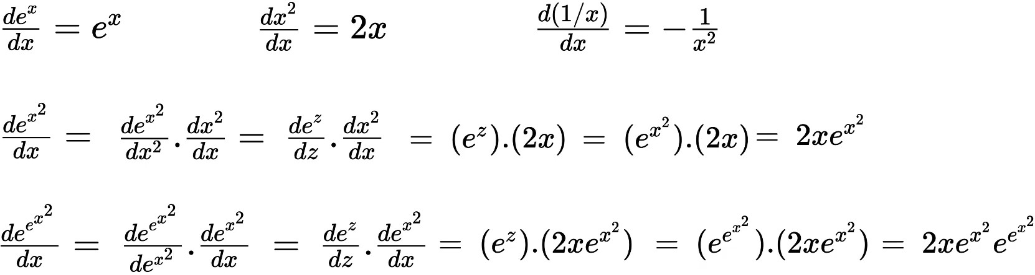

Chain rule
= _{e}x2 _{e}y
x
h=x²
Y= f(h)= e^{h}
sqr
exp

Slide 38
Backpropagation
The partial derivative notation is used to specify the derivative of a function of more than one variable with respect to one of its variables.
The gradient of a function f, denoted as ∇f , is the
collection of all its partial derivatives into a vector.

Slide 39
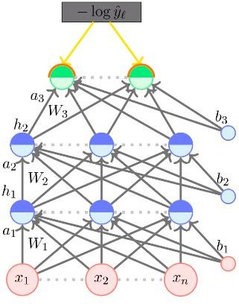
Backpropagation
The partial derivative notation is used to specify the derivative of a function of more than one variable with respect to one of its variables.
The gradient of a function f, denoted as ∇f , is the
collection of all its partial derivatives into a vector.

Slide 40
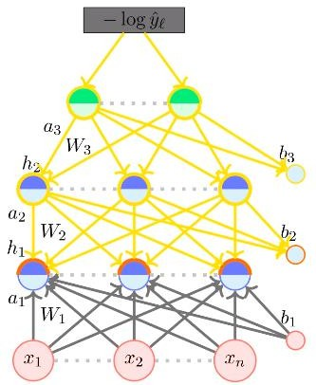
Backpropagation
The partial derivative notation is used to specify the derivative of a function of more than one variable with respect to one of its variables.
The gradient of a function f, denoted as ∇f , is the
collection of all its partial derivatives into a vector.

Slide 41
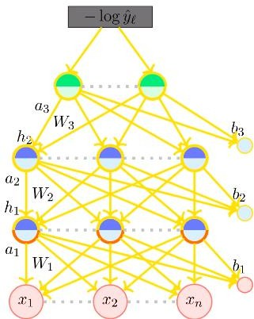
Backpropagation
The partial derivative notation is used to specify the derivative of a function of more than one variable with respect to one of its variables.
The gradient of a function f, denoted as ∇f , is the
collection of all its partial derivatives into a vector.

Slide 42
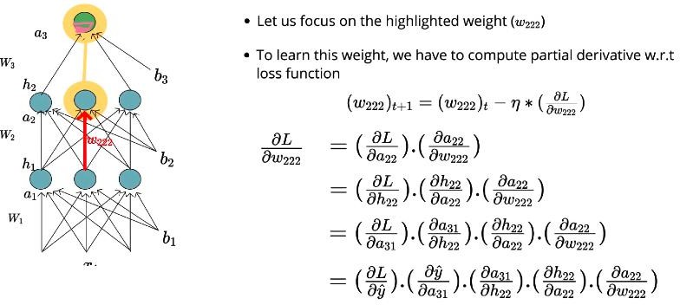
Learning algorithm- Back propagation

Slide 43
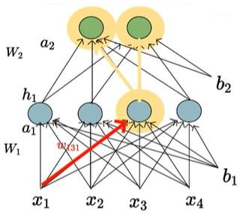
Multiple paths
There are 2 different paths connecting w131 with loss
function
Consider all those paths through which gradient is flowing back
Sum up the gradients along all these paths( 2 here)
ie Apply independent chain rules to all those multiple paths and sum up the derivatives across all these paths and get the total derivative of the loss function w.r.t w131

Slide 44

Learning Algorithm- backpropagation

Slide 45
Practice Problem- Back Propagation

Slide 46



The goal of backpropagation is to optimize the weights so that the neural network can learn how to correctly map arbitrary inputs to outputs.
In order to have some numbers to work with, here are the initial weights, the biases, and training inputs/outputs:
Given a single training set: given inputs 0.05 and 0.10, we want the neural network to output 0.01 and 0.99.

Slide 47

Forward Pass
Carrying out the same process for h_2 we get:
Notation as per previous slides
Net O1= a1 Outo1=h1

Slide 48

We repeat this process for the output layer neurons, using the output from the hidden layer neurons as inputs.
Here’s the output for o_1:

Slide 49

Calculating the Total Error
We can now calculate the error for each output neuron using the squared error function and sum them to get the total error:

Slide 50




The Backwards Pass

Slide 51



Slide 52



Slide 53

Hyper parameter tuning

